Slide 1
VLSI Physical Design
Team Members:
Riya Jain (20ecu008)
Vasu Singh (20ecu021)
Under the guidance of:
Dr. Vandana Khanna

Slide 2
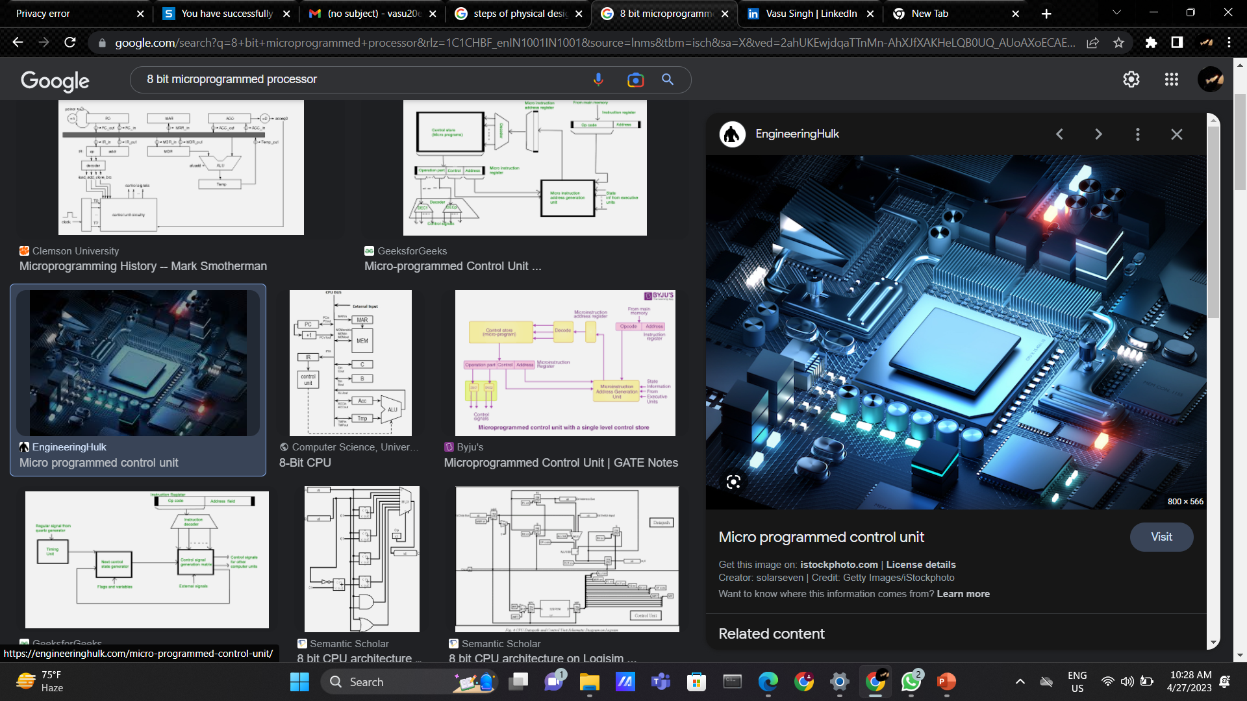
8-BIT Microprogrammed Processor
A microprogrammed control unit is a complex programmable unit that outputs control signals to data path according to its "microprogram".
A microprogrammed control unit can be regarded as a simple computer. In this view, a processor has another simple processor inside it which is its control unit.
Controlling a data path is described by its microprogram.

Slide 3

Logic Synthesis
Logic synthesis is the process of automatic production of logic components, in particular digital circuits.
It is a subject about how to abstract and represent logic circuits, how to manipulate and transform them, and how to analyze and optimize them.

Slide 4
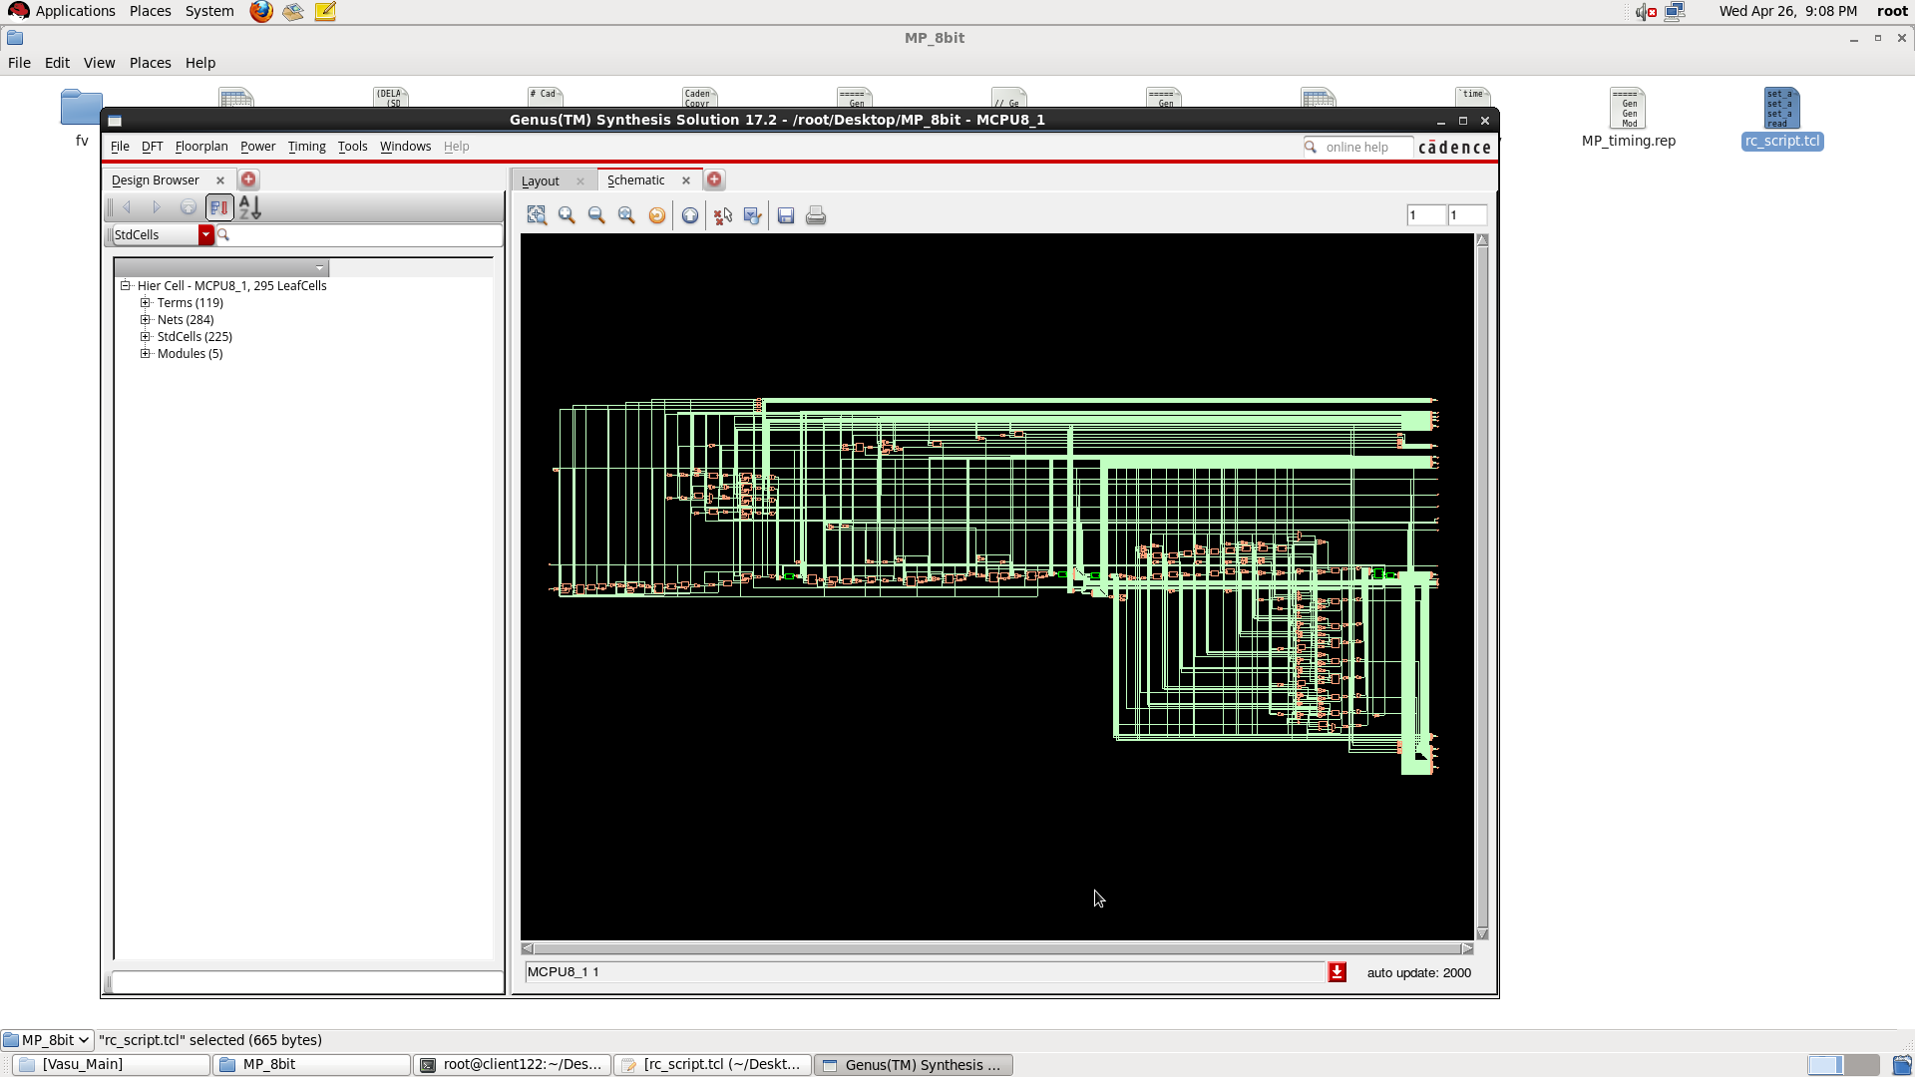
Schematic

Slide 5
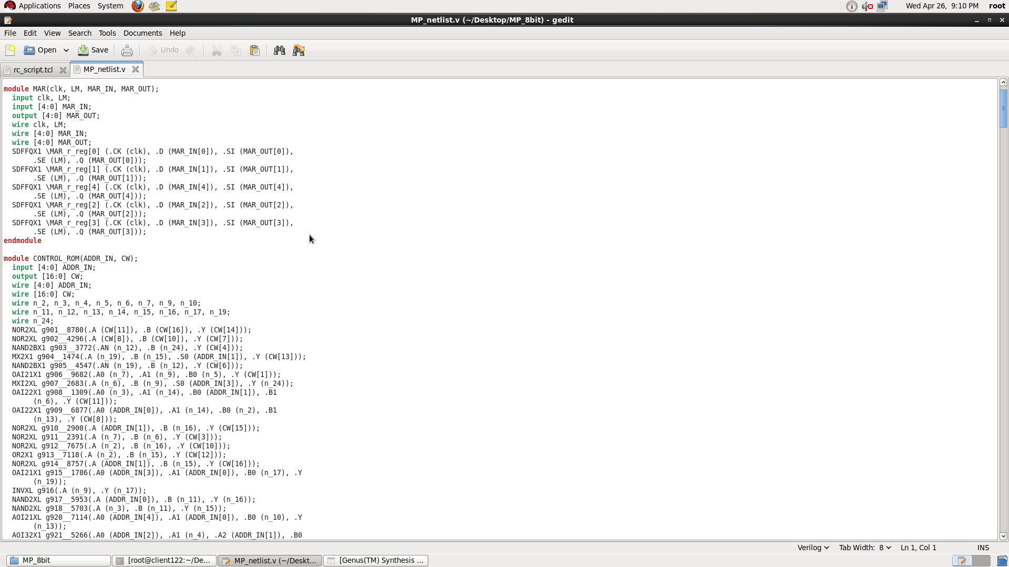
Generated Netlist

Slide 6
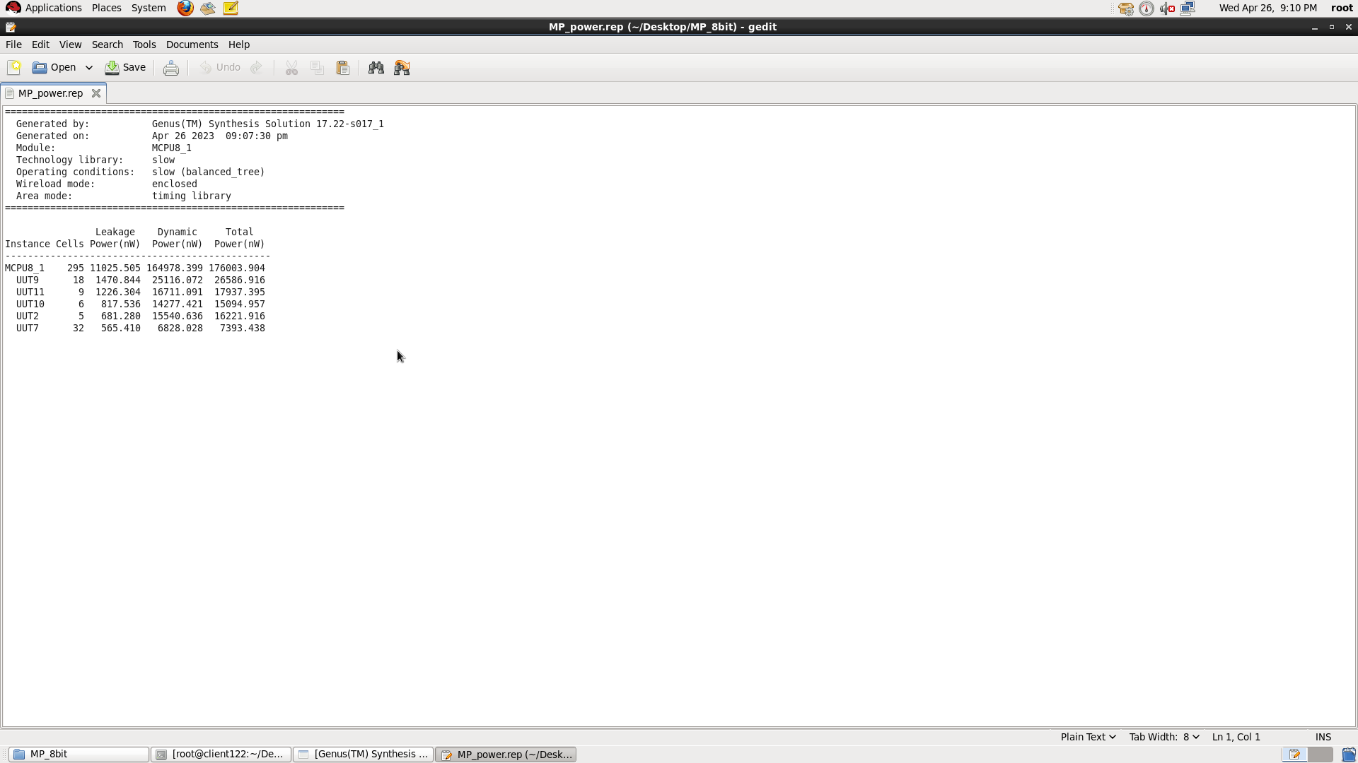
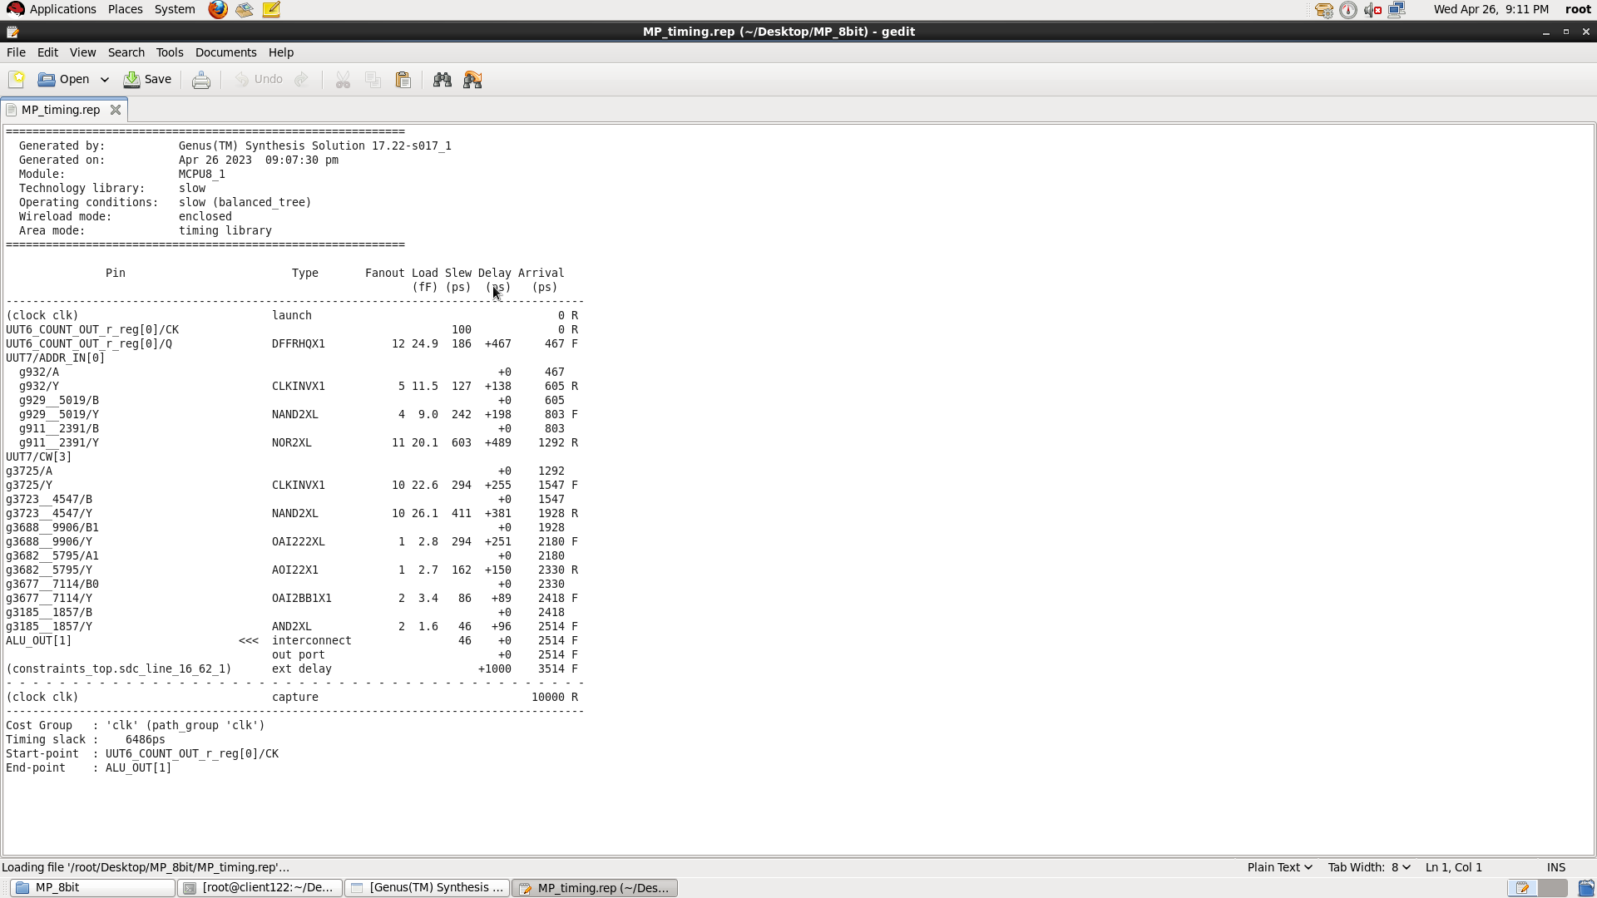
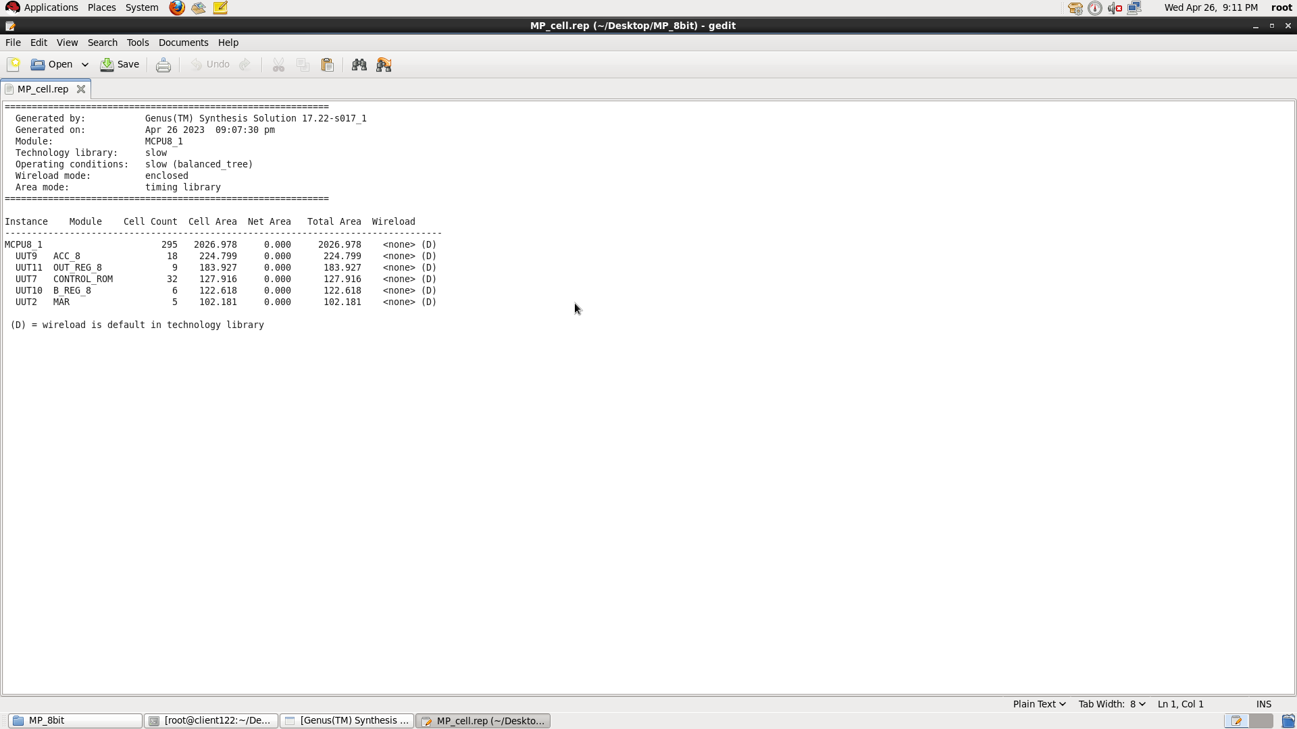
After Genus Timing
After Genus Power
After Genus Area

Slide 7

Floor and Power planning
Floor planning is the first step in physical implementation of a design.
Floor planning is an iterative process and is improved based on the feedback from placement results.
Power planning means to provide power to every macros, standard cells, and all other cells are present in the design.

Slide 8
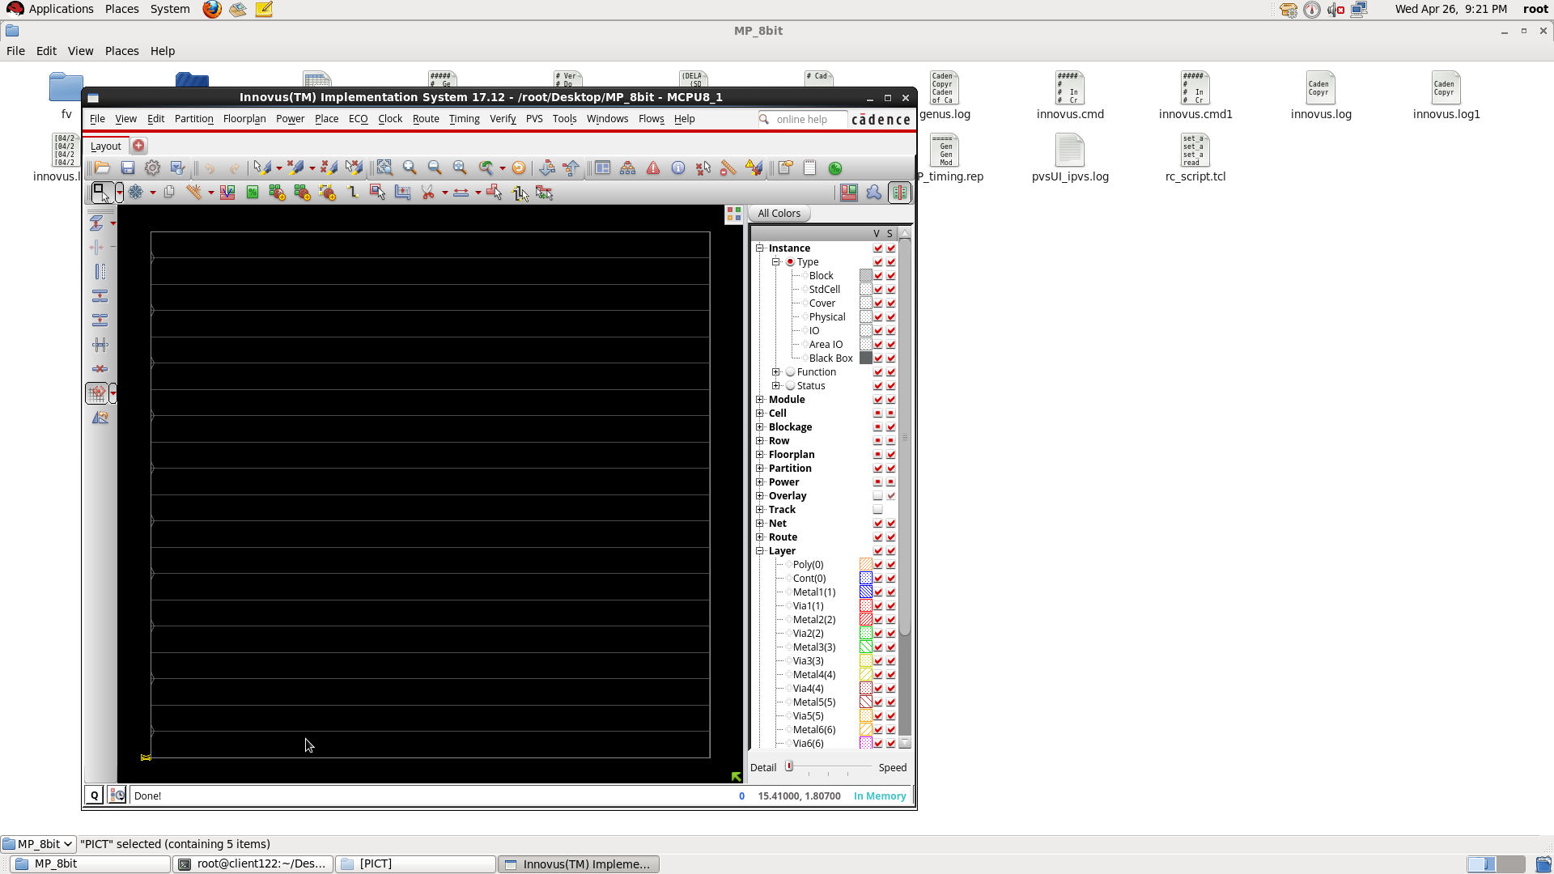
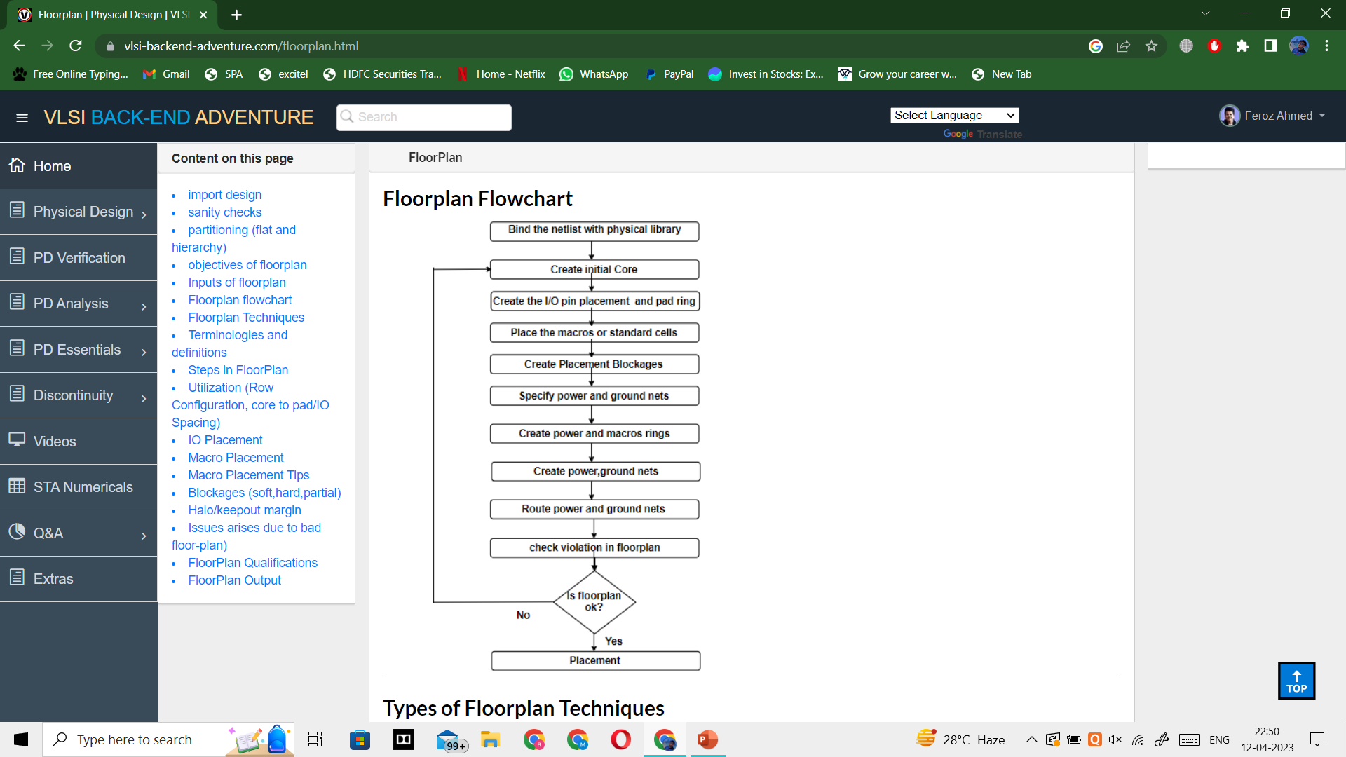

Slide 9
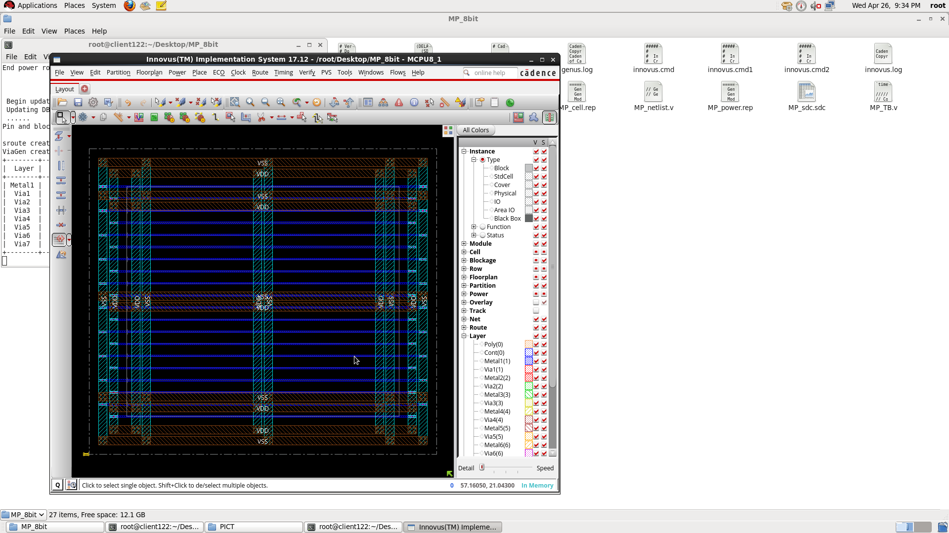
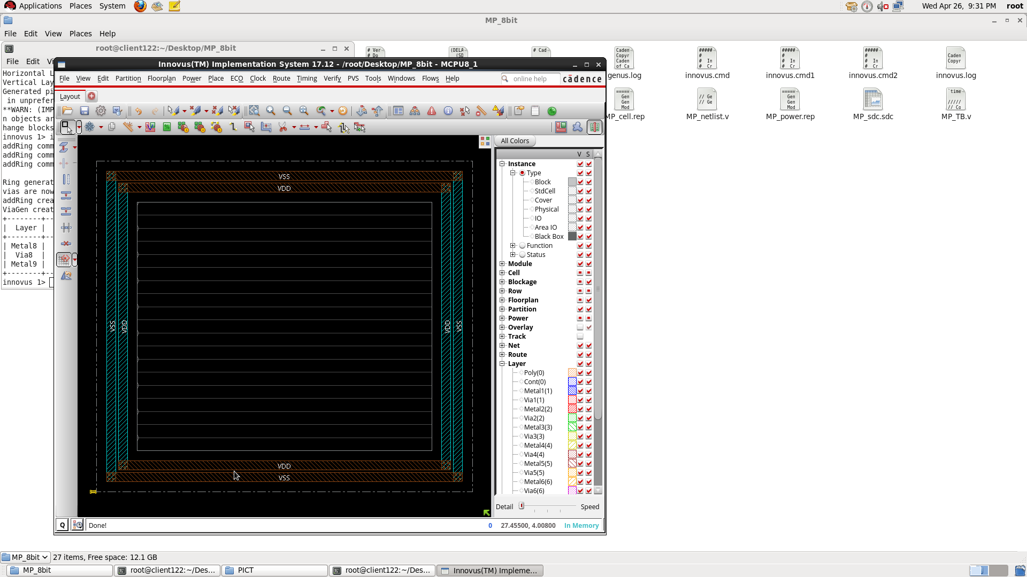
ADD Stripes
Special Route
ADD Rings

Slide 10
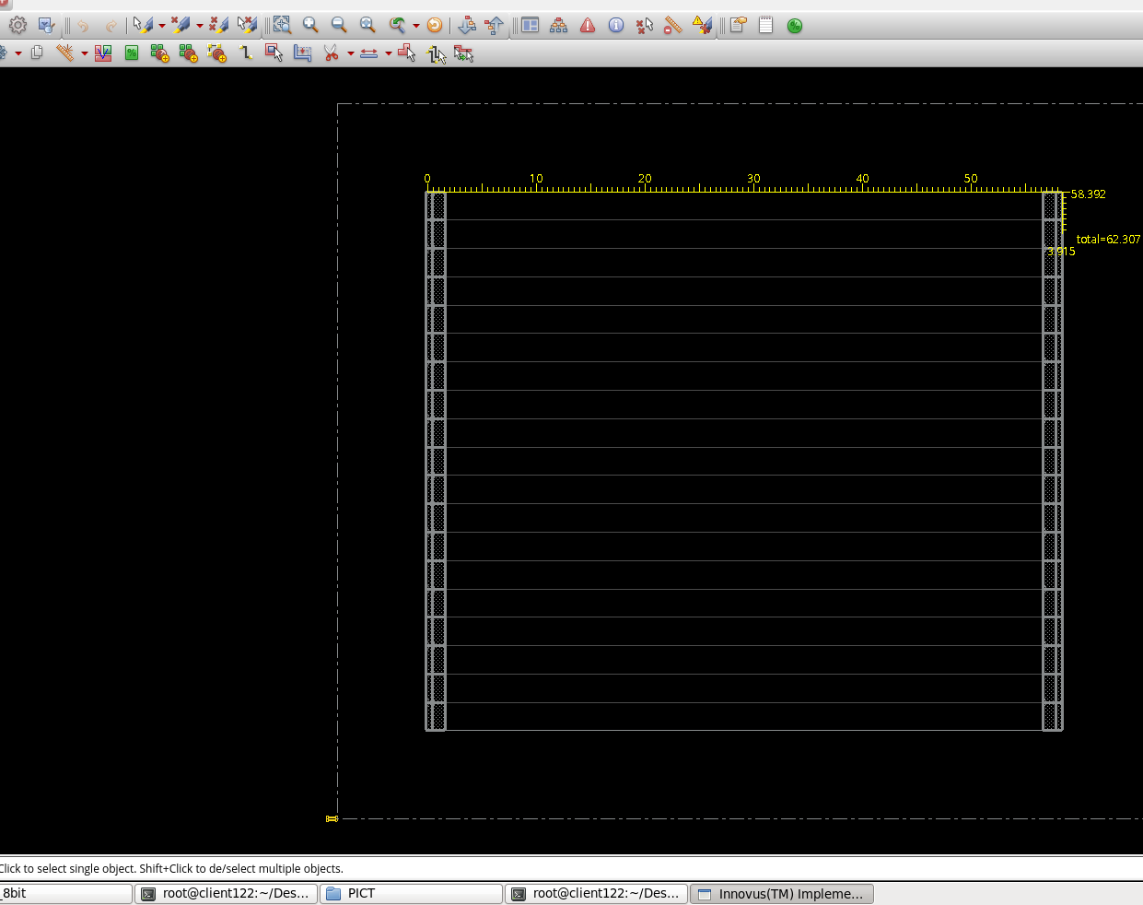
Pre-Placement
End Cap and Well Taps

Slide 11
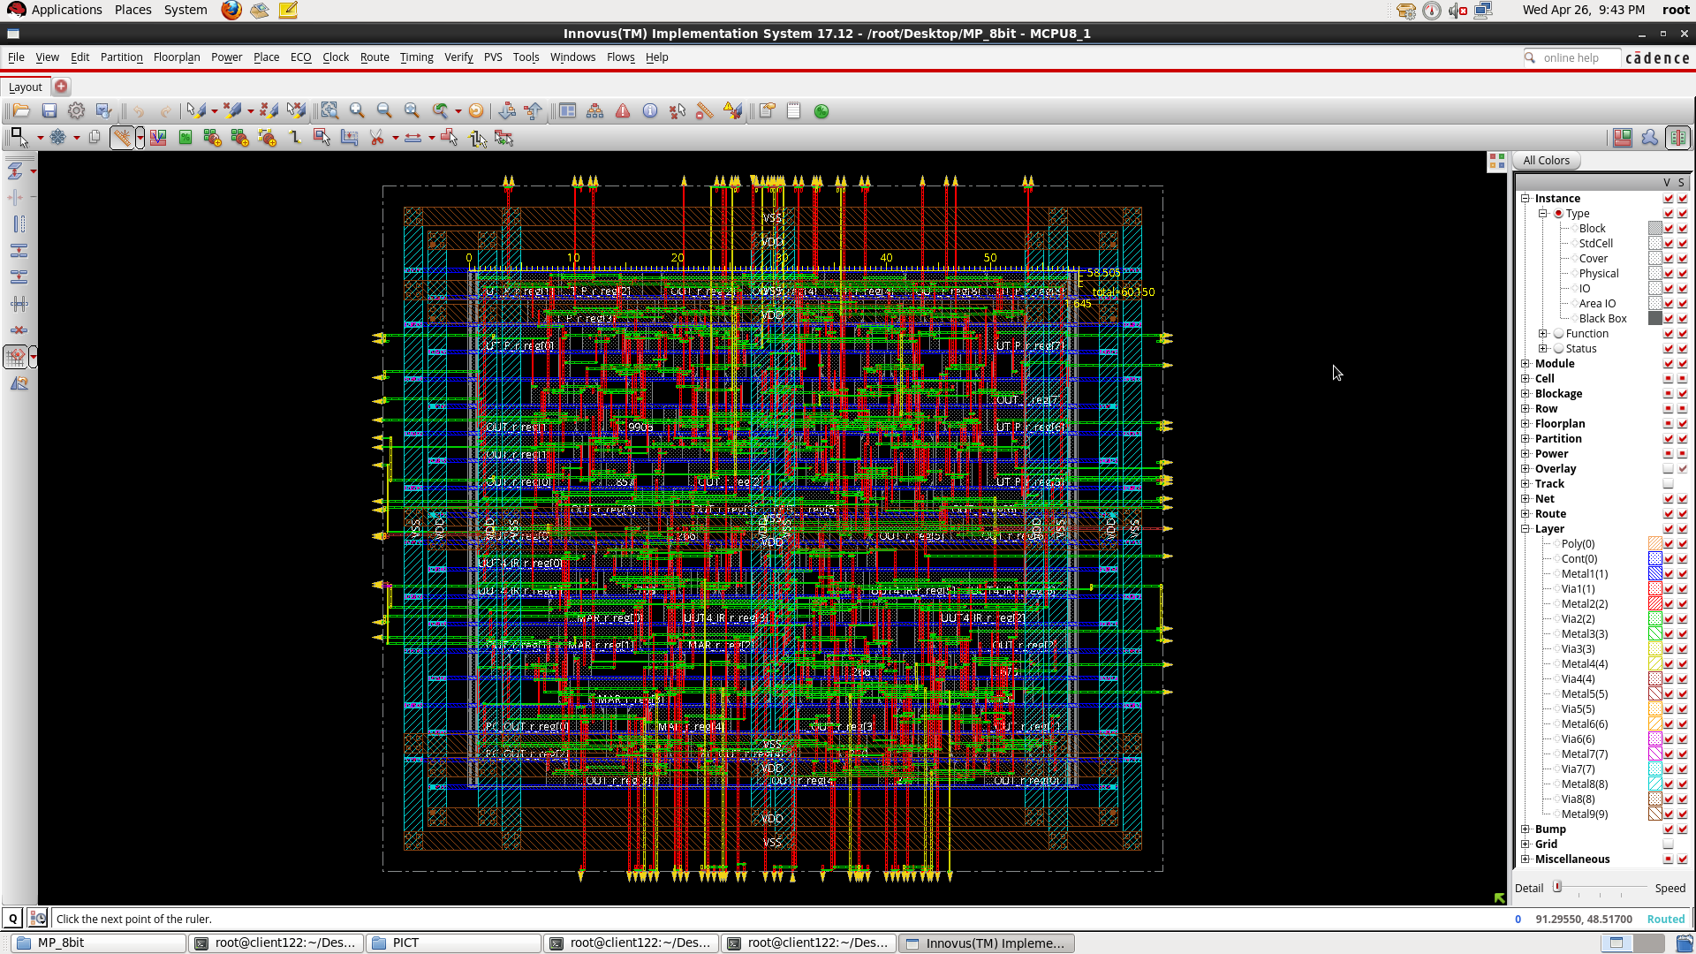
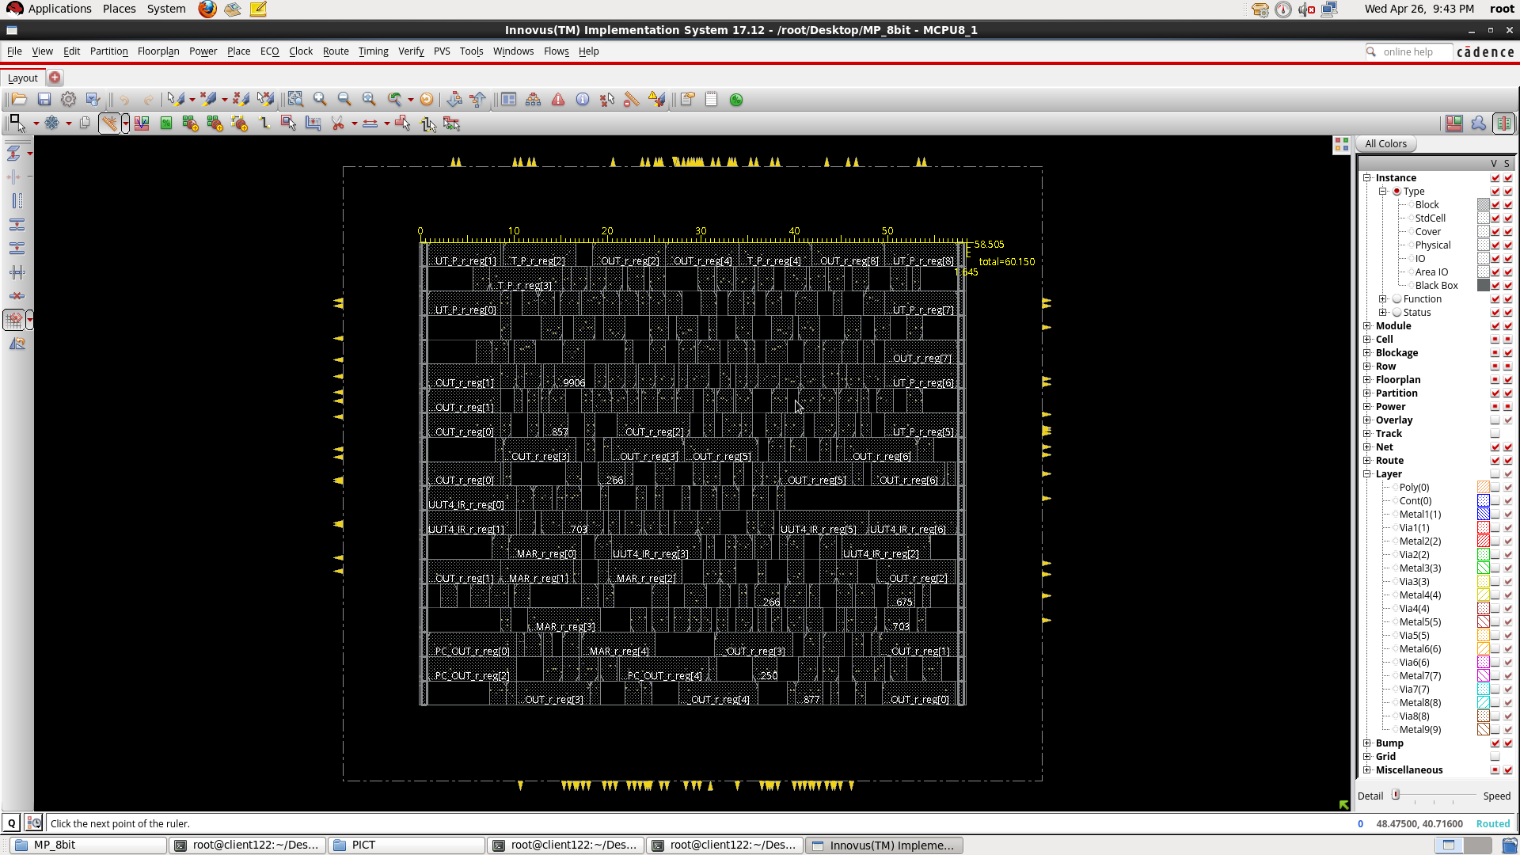
Placement

Slide 12
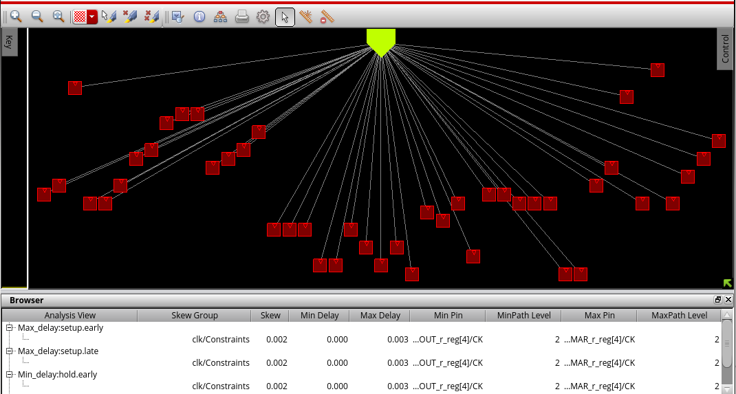
CLOCK TREE SYNTHESIS

Slide 13
Routing
Routing in VLSI is making physical connections between signal pins using metal layers.
Objective
-> skew requirement
-> Open circuit clean
-> routed paths must meet setup and hold timing margin
-> DRVs max. capacitance/transitions must be under the limit
Goals
-> minimize the total wire length
-> minimize the critical path delay
-> minimize the congestion hotspots
-> meeting the timing DRCs and obtaining a good timing QoR.

Slide 14
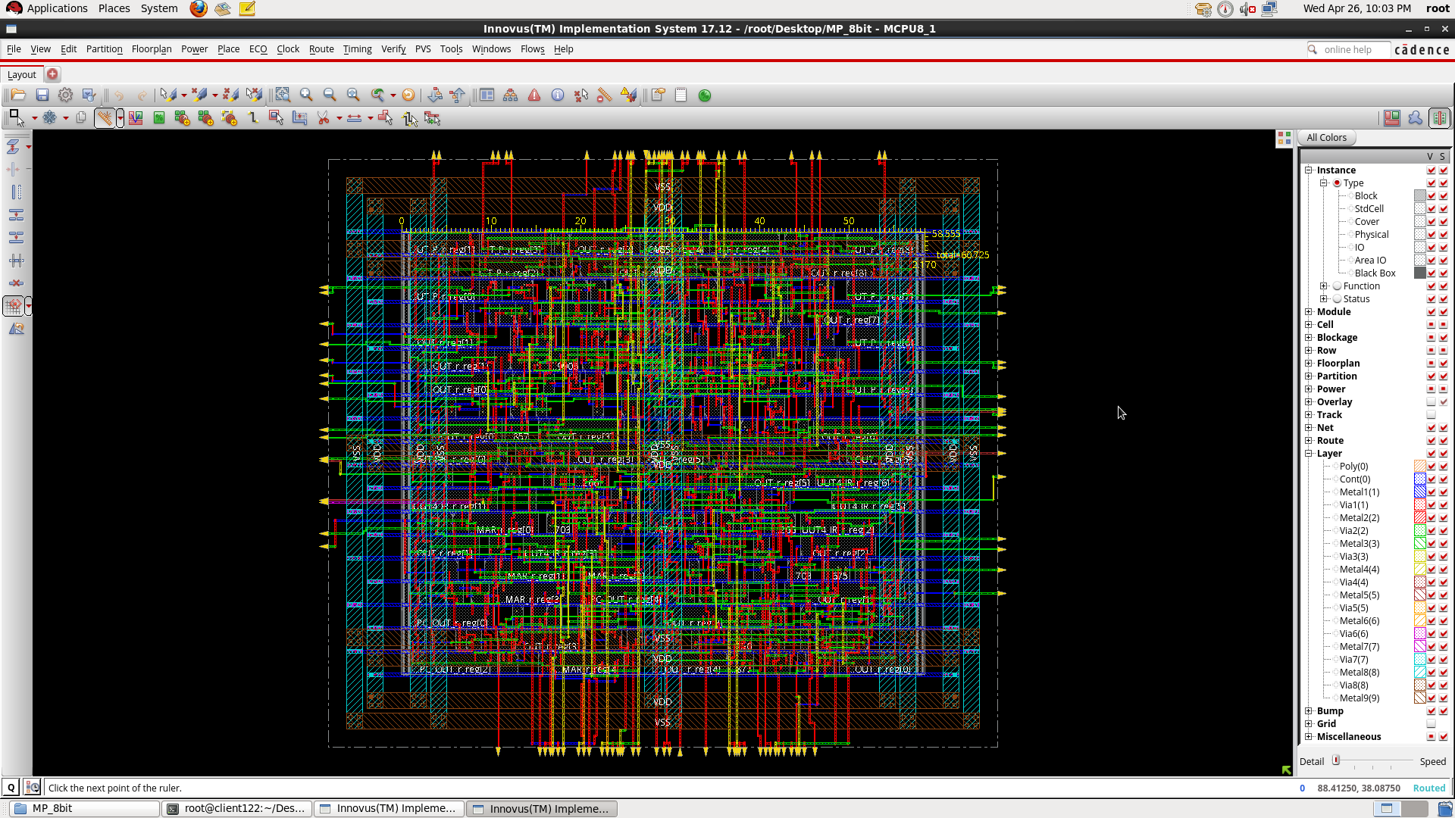

Slide 15

Thank You

